Slide 1
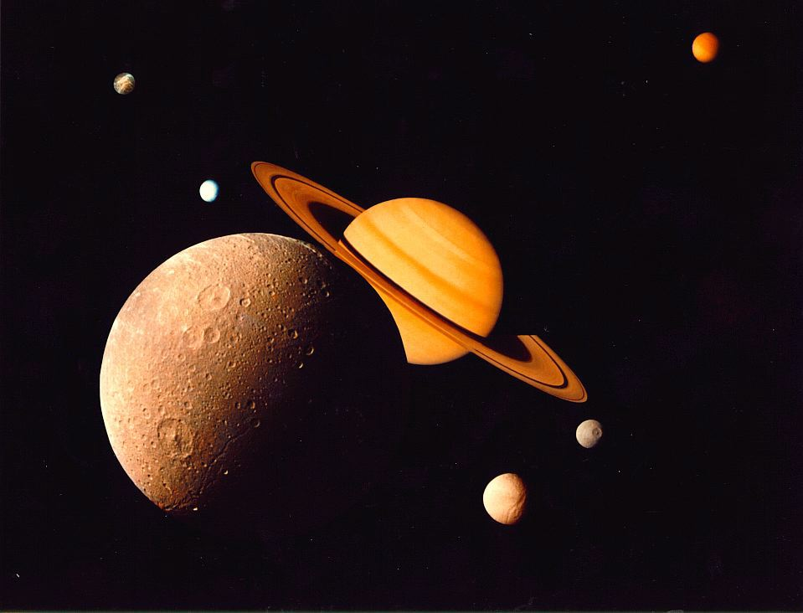
Moons, Rings & Other Things

Slide 2
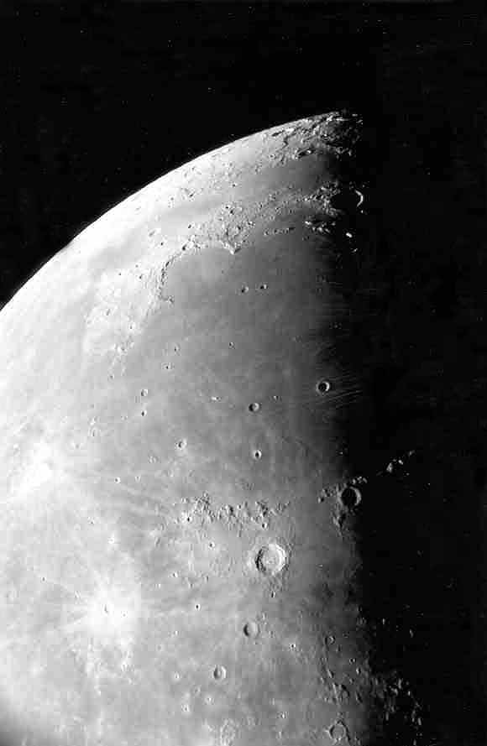
Moon maria as seen through the telescope.
Photo by Jim Fullerton

Slide 3
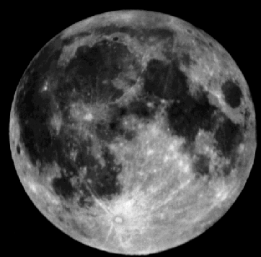
The maria (mare) are the smooth dark areas on the surface of the Moon.
Mare
Highlands

Slide 4
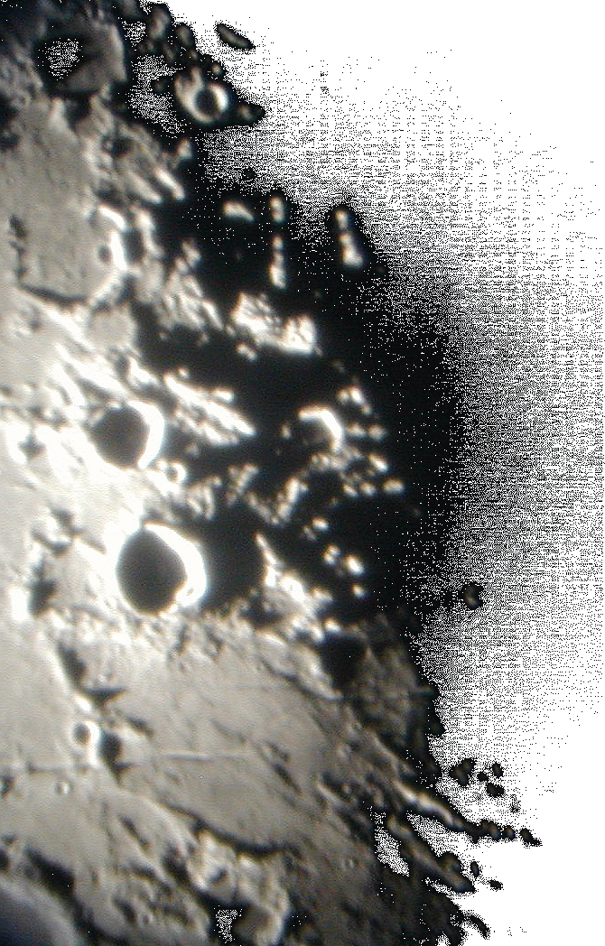
The Moon=s many craters and other features are best seen near the terminator - the line between day and night.
Photo by Lake Afton Public Observatory

Slide 5
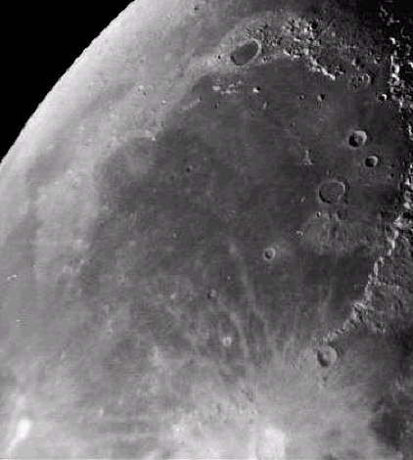
This photo shows a smooth floored lunar mare. You can easily see the ancient rim of the original impact basin.
Mare Imbrium

Slide 6
The maria were formed about 3.5 – 4 billion years ago.
Lava flowed through cracks in the lunar surface and filled in low laying areas.
Mare Imbrium

Slide 7
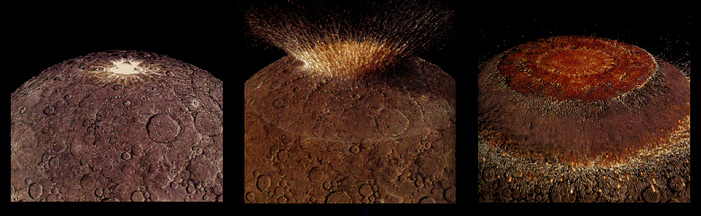
Four billion years ago the impact from a large asteroid formed a huge multi-ringed basin which then thinned and fractured the lunar crust.

Slide 8
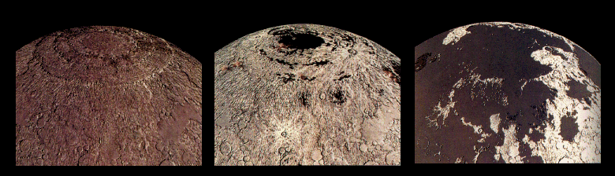
Fluid lavas from beneath the moon’s crust flowed out and flooded the low regions of the lunar surface – covering up many craters.

Slide 9
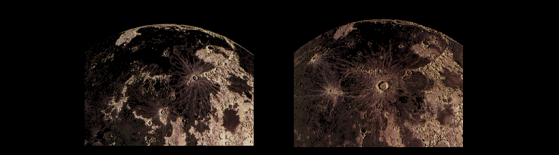
Less than a billion years after they began, the lavas ceased flowing out onto the Moons surface. However, occasionally new craters were created on top of these ancient flows.

Slide 10
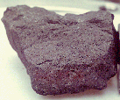
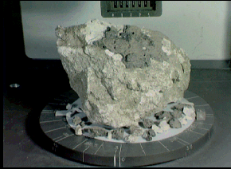
Lunar rock samples from the moon’s maria are dark colored rocks.
Samples from the highland regions are much lighter in color.

Slide 11
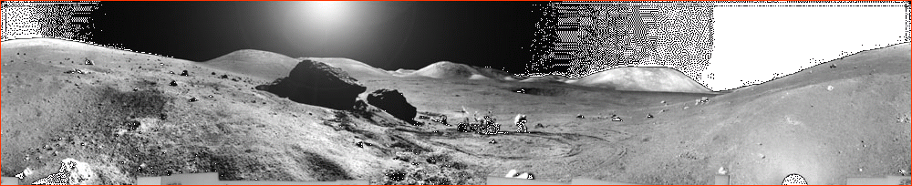
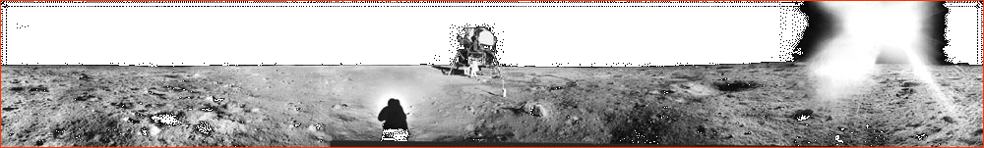
One of these shows the lunar surface from a mare and the other the highlands.
Can you tell which is which?

Slide 12
The highlands are rugged.
The mare are smooth & flat.

Slide 13
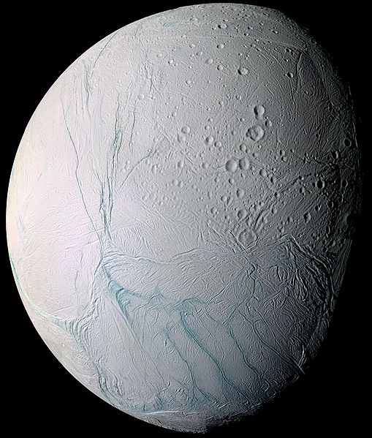
Saturn’s moon, Enceladus, exhibits areas that have few craters and are relatively smooth like
the mare of our Moon.
These areas have been resurfaced by water from Enceladus’ interior instead of liquid rock like the Moon.

